Slide 1
FR2052A Reconciliation Tools
Alex Fu

Slide 2
FR2052A Reconciliation Tools
Target Data to Reconcile
Tool Framework
Tool Usage

Slide 3
Reconciliation Target Data
Financial Data Table (FDT)
Reference Number
Principal GL
Relationship
Customer Name
Value Date
Fair Market Value
Exchange Rate
Principal Balance
Principal Balance AL
Cash Flow Table (CFT)
Reference Number
Source Currency Amount
Base Equivalent Amount
Maturity Date
Amount Source
Asset Liability
Item
For Asset Inflow Only

Slide 4
Reconciliation Framework
1. Reconcile CFT with FDT
2. Reconcile FR2052A with CFT/FDT
Asset Inflow
Secured Inflow
Unsecured Inflow
CFT
FDT
Reconciled CFT & FDT
Other Inflow
Wholesale Outflow
Deposit Outflow
Other Outflow

Slide 5
1. Reconcile CFT with FDT
Setup Inputs & Run
Interpret Errors

Slide 6
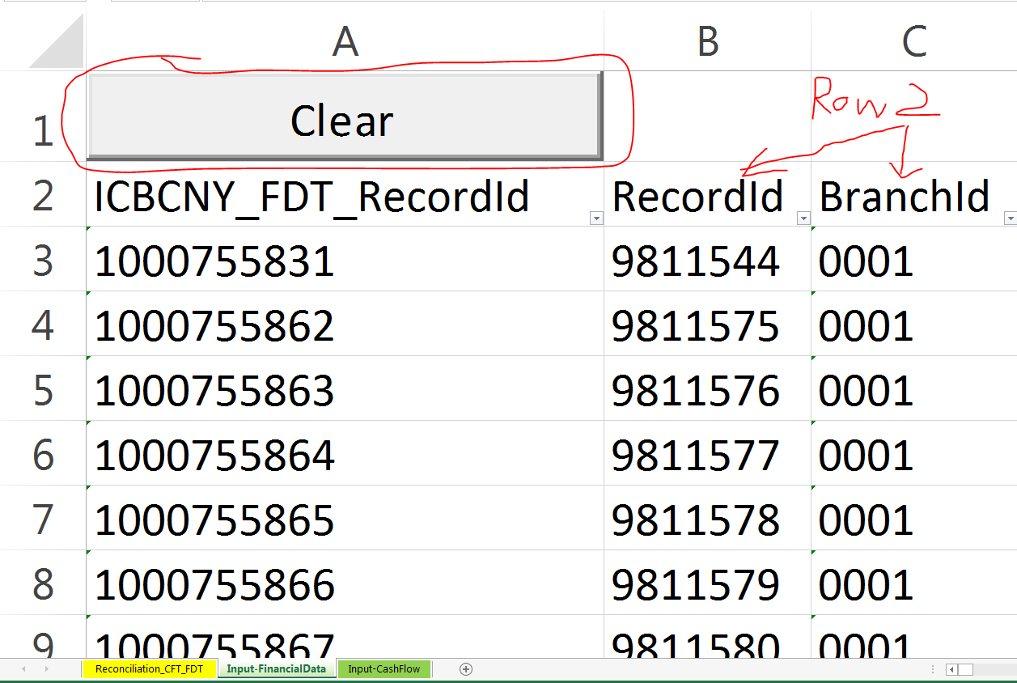
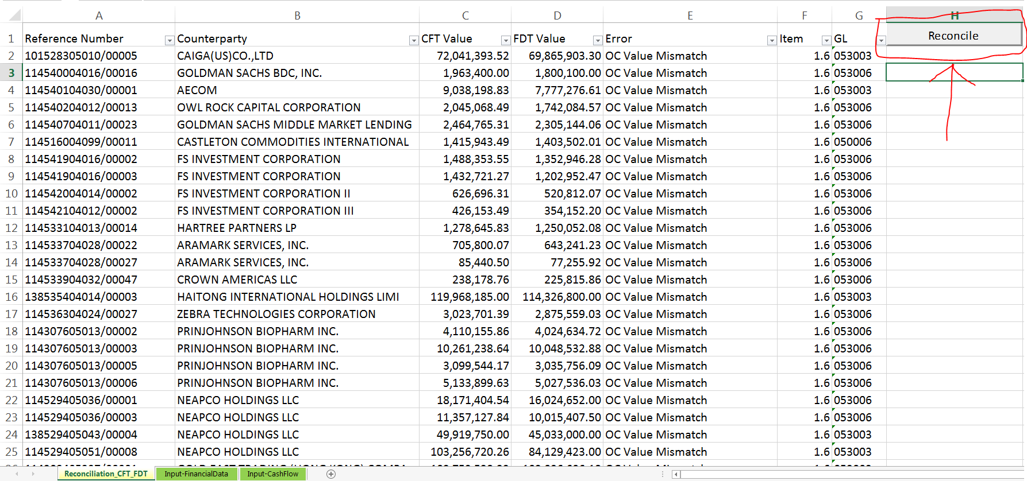
Setup Inputs & Run
1. Clear Old Inputs: Click the “Clear” buttons on worksheets “Input-FinancialData” & “Input-CashFlow”
2. Add New Inputs: Copy & paste new data into worksheets “Input-FinancialData” & “Input-CashFlow”, with column names on row 2
3. Reconcile : Click the “Reconcile” button on worksheet “Reconciliation_CFT_FDT”

Slide 7
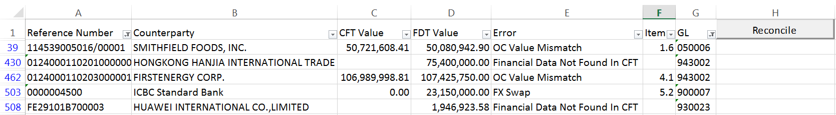
Interpret Errors
Error Types:
Financial Data Not Found In CFT
Cash Flow Not Found In FDT
OC Value Mismatch
Converted Value Mismatch
Forward Start OC Value Mismatch
Forward Start Converted Value Mismatch
Error Info:
Reference Number
Counterparty
CFT Value
FDT Value
Error
Item
GL

Slide 8
2. Reconcile FR2052A with CFT/FDT
Setup Inputs & Run
Interpret Errors

Slide 9
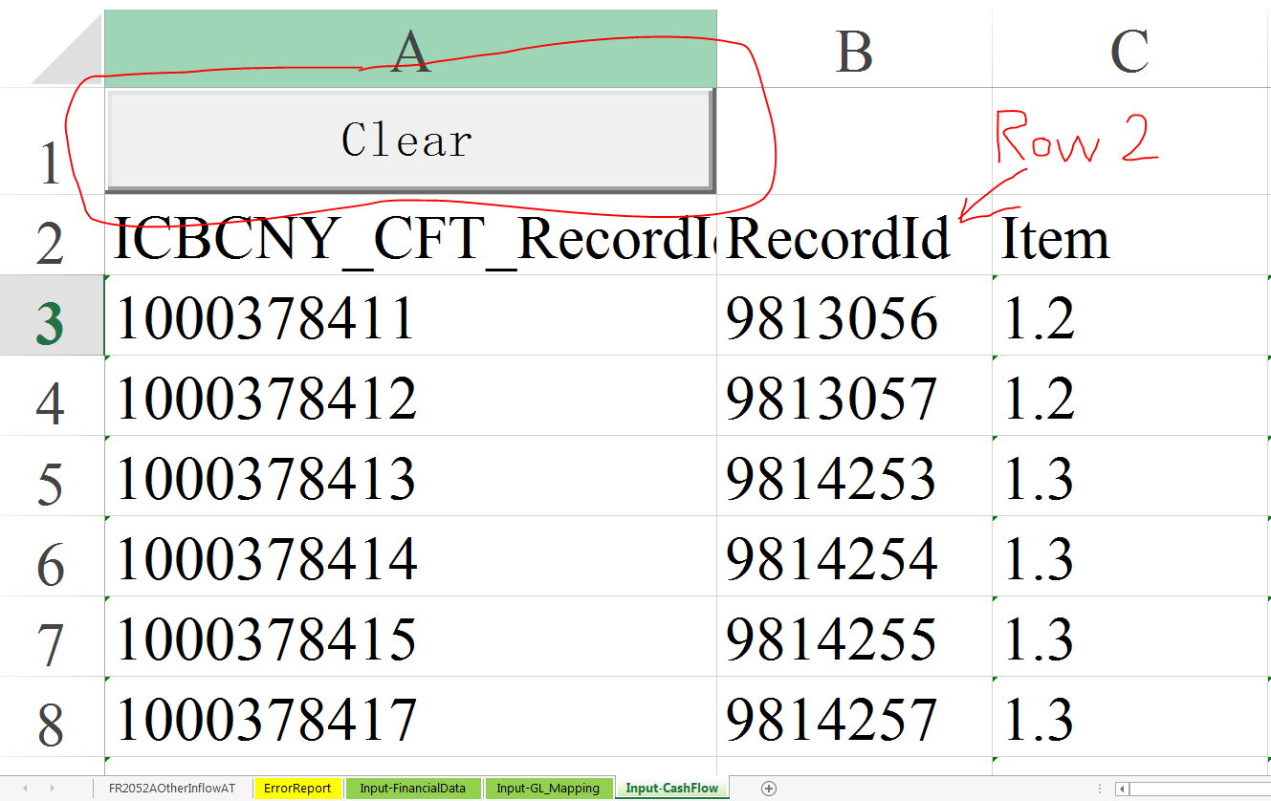
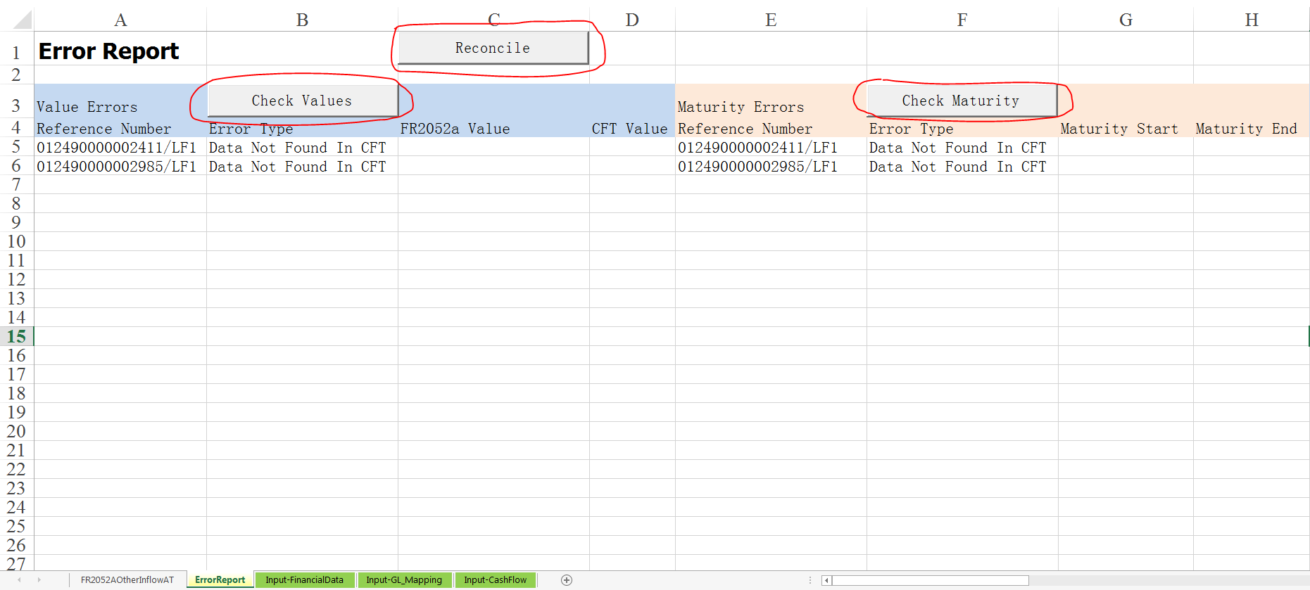
Setup Inputs & Run
1. Clear Old Inputs: Click the “Clear” buttons on worksheets “Input-FinancialData” & “Input-CashFlow”
2. Add New Inputs: Copy & paste new data into worksheets “Input-FinancialData” & “Input-CashFlow”, with column names on row 2
3. Reconcile : Click the “Reconcile” button on worksheet “ErrorReport” or click other buttons for specific checks

Slide 10
Interpret Errors
Checked Items
Missing Cash Flows
Values
Internal Counterparties
Maturity Buckets
Asset-Liability Indicators

Slide 11
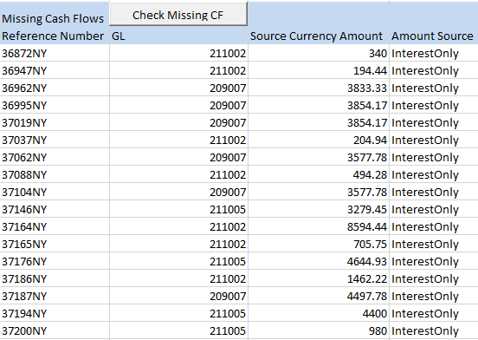
Missing Cash Flows
Error Info:
Reference Number
GL
Source Currency Amount
Amount Source

Slide 12
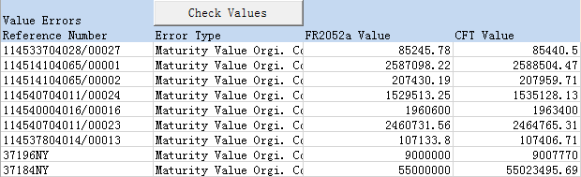

Values
Error Types:
Maturity Value Orgi. Ccy
Maturity Value
Currency Conversion
Data Not Found in CFT
Error Info:
Reference Number
Error Type
FR2052A Value
CFT Value

Slide 13
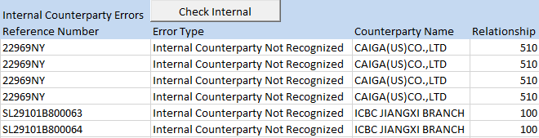
Internal Counterparties
Error Types:
Internal Counterparty Not Recognized
Blank Internal Counterparty Entry
Incorrect Internal Counterparty Recognition
Data Not Found in CFT
Error Info:
Reference Number
Error Type
Counterparty Name
Relationship

Slide 14
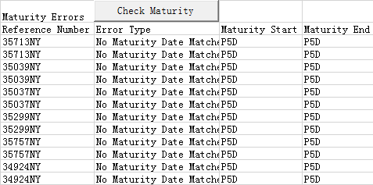
Maturities
Error Types:
Please enter report date in Cell A4 with the format of "Report Date: MM/DD/YYYY"
Missing Maturity Start (End)
Invalid Maturity Bucket Start (End) Input
Wrong Bucket Start (End)
Wrong Maturity Bucket
No Maturity Date Matches the Bucket
Data Not Found in CFT
Error Info:
Reference Number
Error Type
Maturity Start
Maturity End

Slide 15

Asset-Liability Indicators
Error Types:
AL Indicator Error
AL Indicators Mismatch
Inconsistent AL & GL
Data Not Found in CFT
Error Info:
Reference Number
Error Type
AL in FR2052a
AL in CFT

Slide 16
Questions? Suggestions?

Slide 17
Thank You!

